Slide 1
Data Organization and Retrieval (Priority Queue & Heap)
Subhasis Bhattacharjee
Computer Science & Engineering, IIT Jammu

Slide 2
Background
We have discussed Abstract Lists with explicit linear orders
Arrays, linked lists, strings
We saw three cases which restricted the operations:
Stacks, queues, deques
Following this, we looked at search trees for storing implicit linear orders: Abstract Sorted Lists
Run times were generally Θ(ln(n))
We will now look at a restriction on an implicit linear ordering:
Priority queues

Slide 3
Definition
With queues
The order may be summarized by first in, first out
If each object is associated with a priority, we may wish to pop that object which has highest priority
With each pushed object, we will associate a nonnegative integer (0, 1, 2, ...) where:
The value 0 has the highest priority, and
The higher the number, the lower the priority

Slide 4
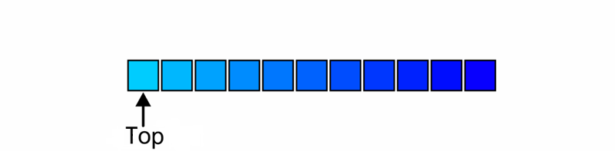
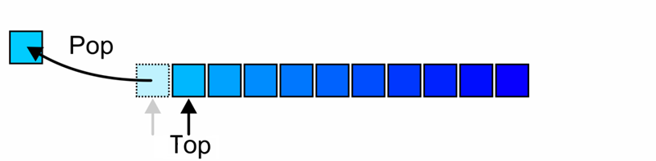
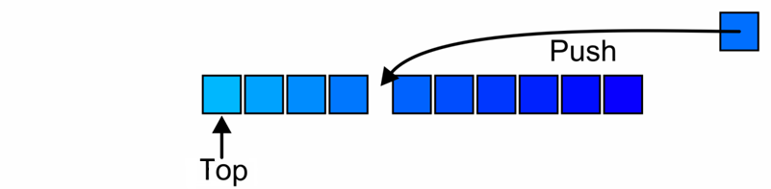
Operations
The top of a priority queue is the object with highest priority
Popping from a priority queue removes the current highest priority object:
Push places a new object into the appropriate place

Slide 5
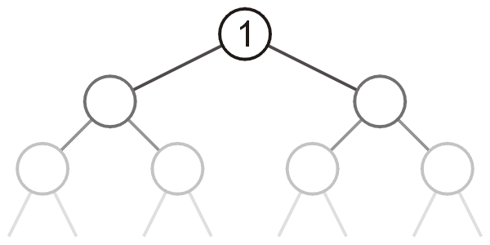
Heaps
Can we do better?
That is, can we reduce some (or all) of the operations down to Θ(1)?
The next topic defines a heap
A tree with the top object at the root
We will look at binary heaps
Numerous other heaps exists:
d-ary heaps
Leftist heaps
Skew heaps
Binomial heaps
Fibonacci heaps
Bi-parental heaps

Slide 6
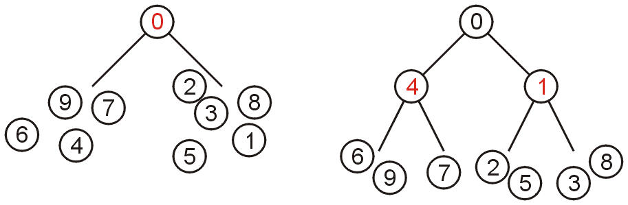
Definition
A non-empty binary tree is a min-heap if
The key associated with the root is less than or equal to the keys associated with either of the sub-trees (if any)
Both of the sub-trees (if any) are also binary min-heaps
From this definition:
A single node is a min-heap
All keys in either sub-tree are greater than the root key

Slide 7
Definition
Important:
THERE IS NO OTHER RELATIONSHIP BETWEEN
THE ELEMENTS IN THE TWO SUBTREES

Slide 8
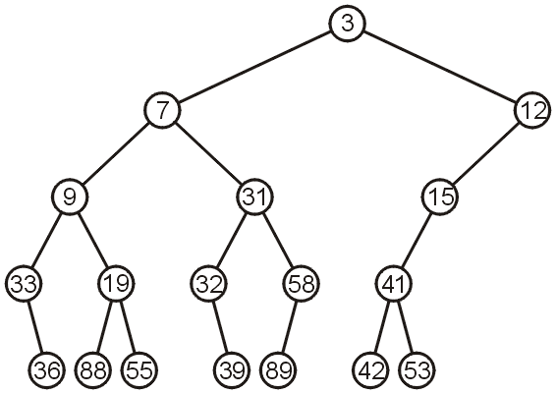
Example
This is a binary min-heap:

Slide 9
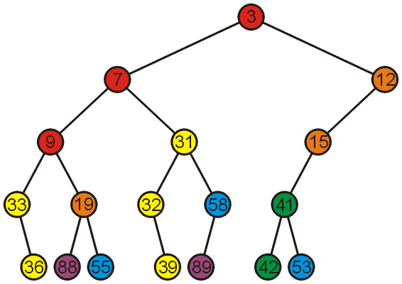
Example
Adding colour, we observe
The left subtree has the smallest (7) and the largest (89) objects
No relationship between items with similar priority

Slide 10
Operations
We will consider three operations:
Top (get top element – i.e., min or max element)
Remove / Pop / Delete
Insert / Push / Add
Notes:
10

Slide 11
Example
We can find the top object in Θ(1) time: 3

Slide 12
Pop
To remove the minimum object:
Promote the node of the sub-tree which has the least value
Recurs down the sub-tree from which we promoted the least value

Slide 13
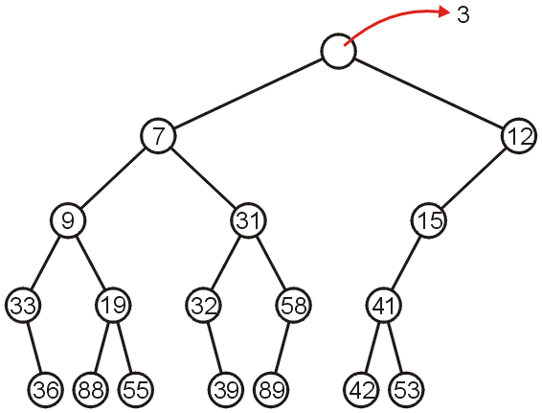
Pop
Using our example, we remove 3:

Slide 14
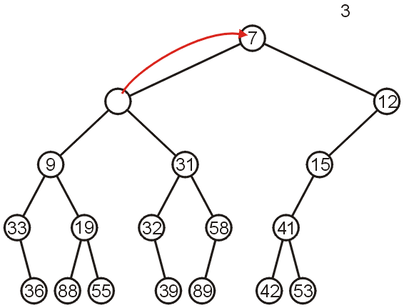
Pop
We promote 7 (the minimum of 7 and 12) to the root:

Slide 15
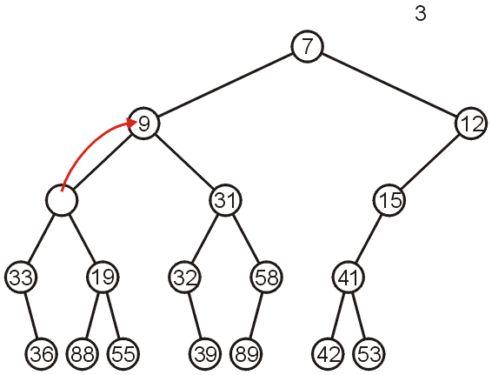
Pop
In the left sub-tree, we promote 9:

Slide 16
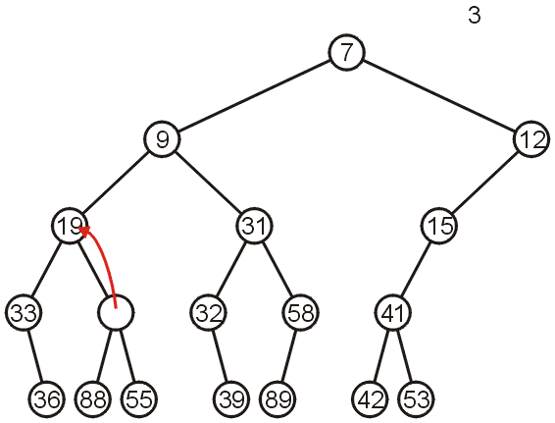
Pop
Recursively, we promote 19:

Slide 17
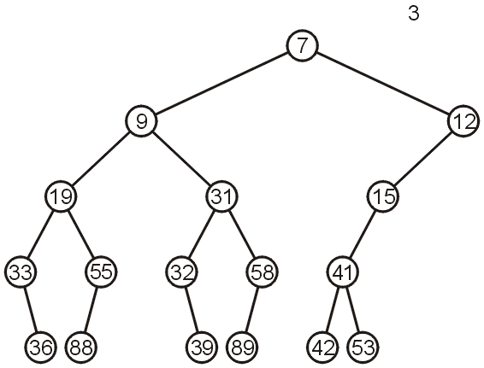
Pop
Finally, 55 is a leaf node, so we promote it and delete the leaf

Slide 18
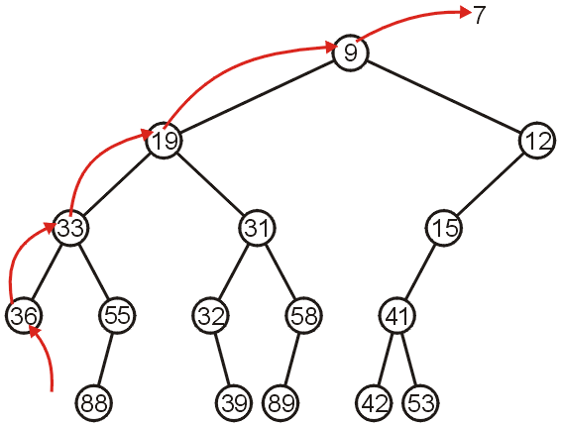
Pop
Repeating this operation again, we can remove 7:

Slide 19
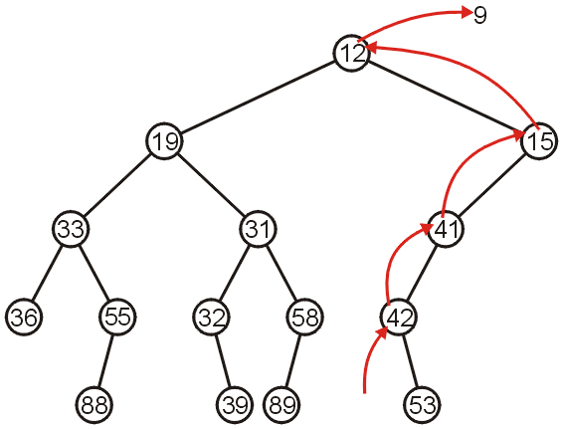
Pop
If we remove 9, we must now promote from the right sub-tree:

Slide 20
Push
Inserting into a heap may be done either:
At a leaf (move it up if it is smaller than the parent)
At the root (insert the larger object into one of the subtrees)
We will use the first approach with binary heaps
Other heaps use the second

Slide 21
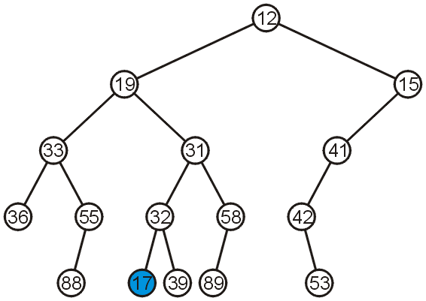
Push
Inserting 17 into the last heap
Select an arbitrary node to insert a new leaf node:

Slide 22
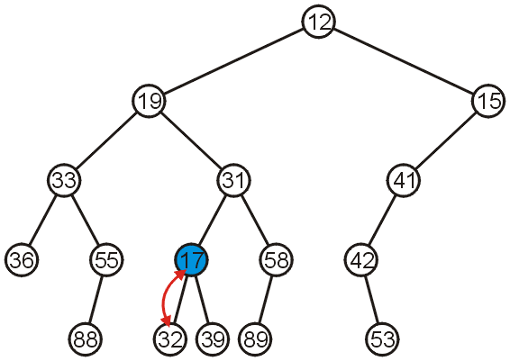
Push
The node 17 is less than the node 32, so we swap them

Slide 23
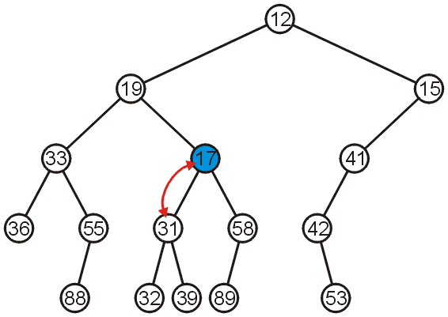
Push
The node 17 is less than the node 31; swap them

Slide 24
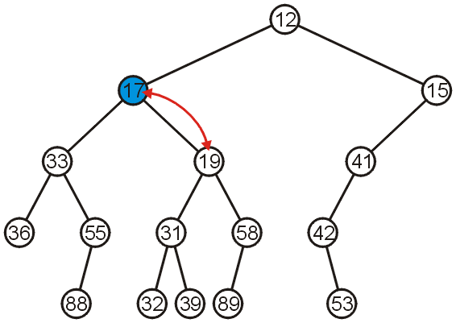
Push
The node 17 is less than the node 19; swap them

Slide 25
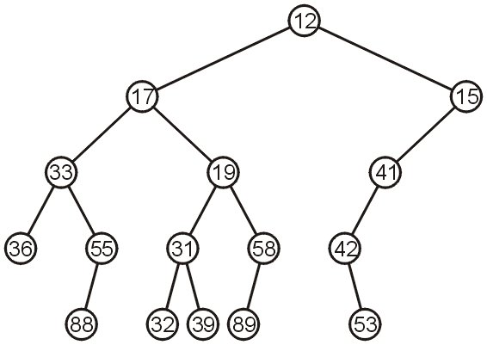
Push
The node 17 is greater than 12 so we are finished

Slide 26
Push
Observation: both the left and right subtrees of 19 were greater than 19, thus we are guaranteed that we don’t have to send the new node down
This process is called percolation, that is, the lighter (smaller) objects move up from the bottom of the min-heap

Slide 27
Implementations
With binary search trees, we introduced the concept of balance
From this, we looked at:
AVL Trees
B-Trees
Red-black Trees (not course material)
How can we determine where to insert so as to keep balance?

Slide 28
Implementations
There are multiple means of keeping balance with binary heaps:
Complete binary trees
Leftist heaps
Skew heaps
We will look at using complete binary trees
In has optimal memory characteristics but sub-optimal run-time characteristics

Slide 29
Complete Trees
By using complete binary trees, we will be able to maintain, with minimal effort, the complete tree structure
We have already seen
It is easy to store a complete tree as an array
If we can store a heap of size n as an array of size Θ(n), this would be great!

Slide 30
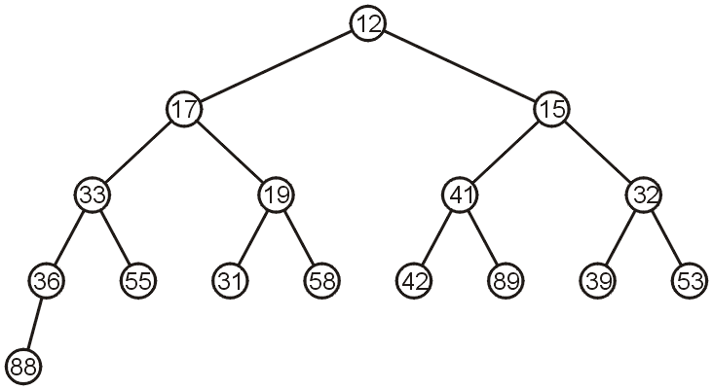
Complete Trees
For example, the previous heap may be represented as the following (non-unique!) complete tree:

Slide 31
Complete Trees: Push
If we insert into a complete tree, we need only place the new node as a leaf node in the appropriate location and percolate up

Slide 32
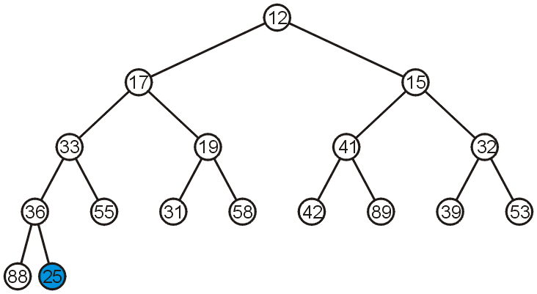
Complete Trees: Push
For example, push 25:

Slide 33
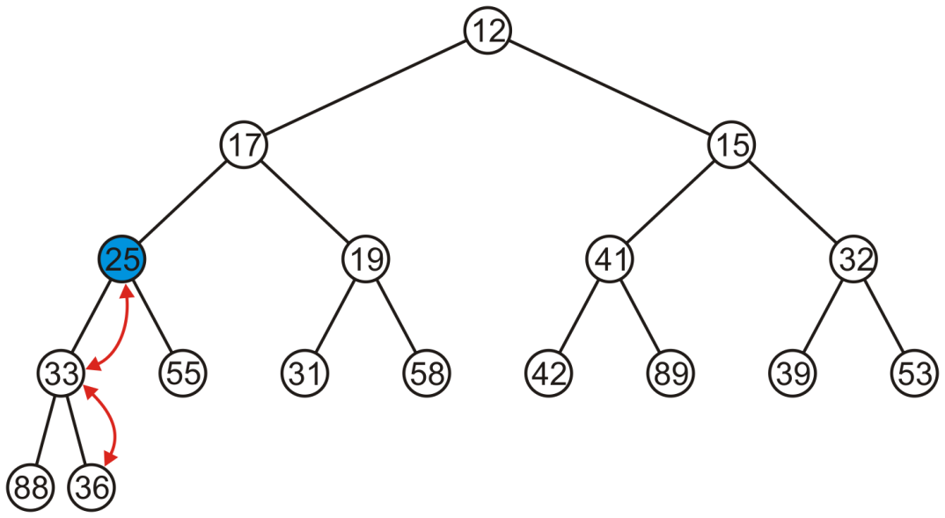
Complete Trees: Push
We have to percolate 25 up into its appropriate location
The resulting heap is still a complete tree

Slide 34
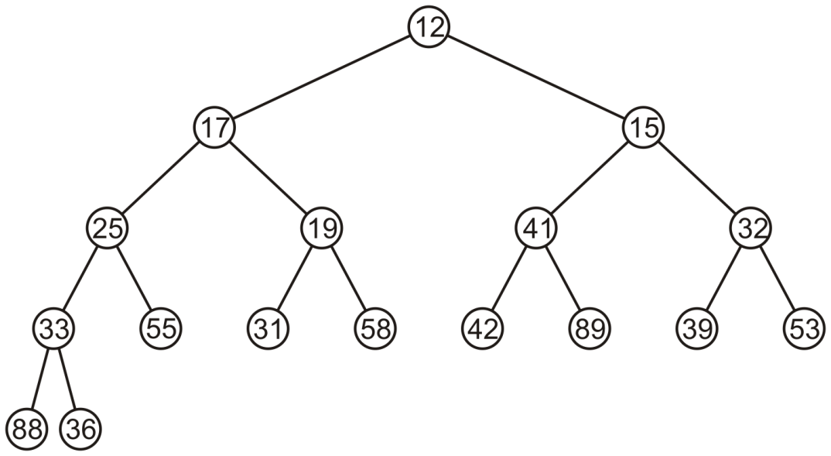
Complete Trees: Pop
Suppose we want to pop the top entry: 12

Slide 35
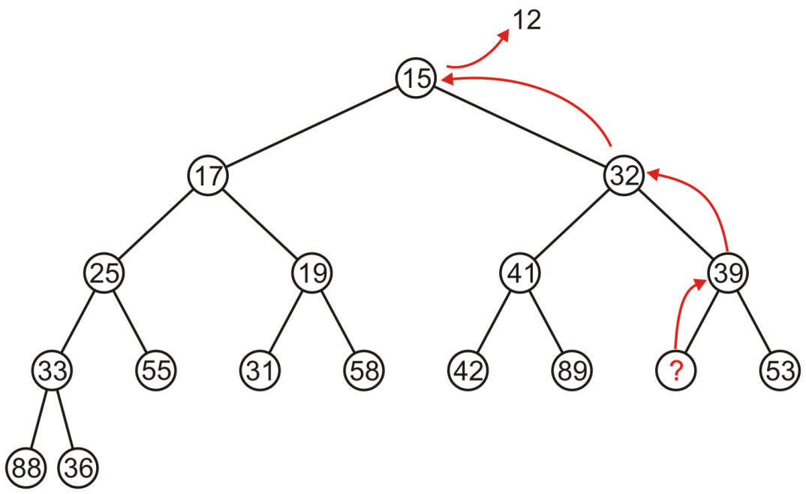
Complete Trees: Pop
Percolating up creates a hole leading to a non-complete tree

Slide 36
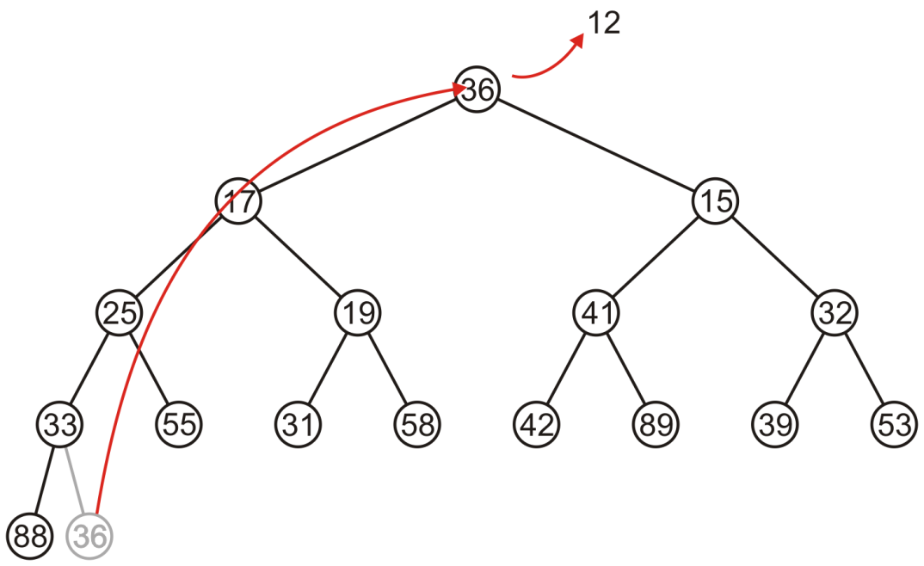
Complete Trees: Pop
Alternatively, copy the last entry in the heap to the root

Slide 37
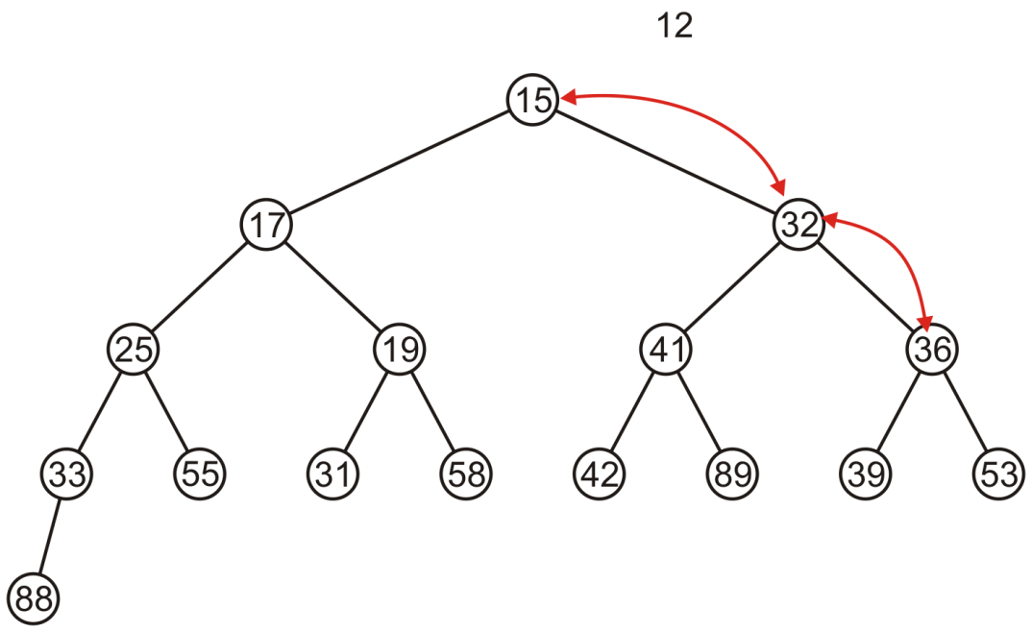
Complete Trees: Pop
Now, percolate 36 down swapping it with the smallest of its children
We halt when both children are larger

Slide 38
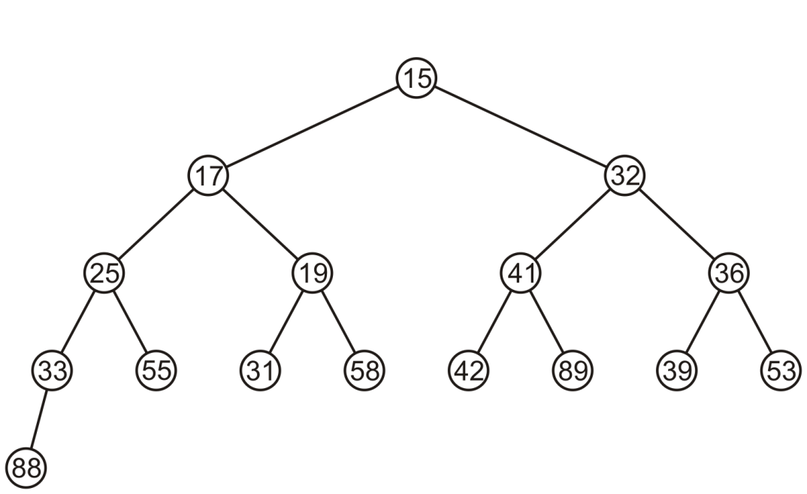
Complete Trees: Pop
The resulting tree is now still a complete tree:

Slide 39
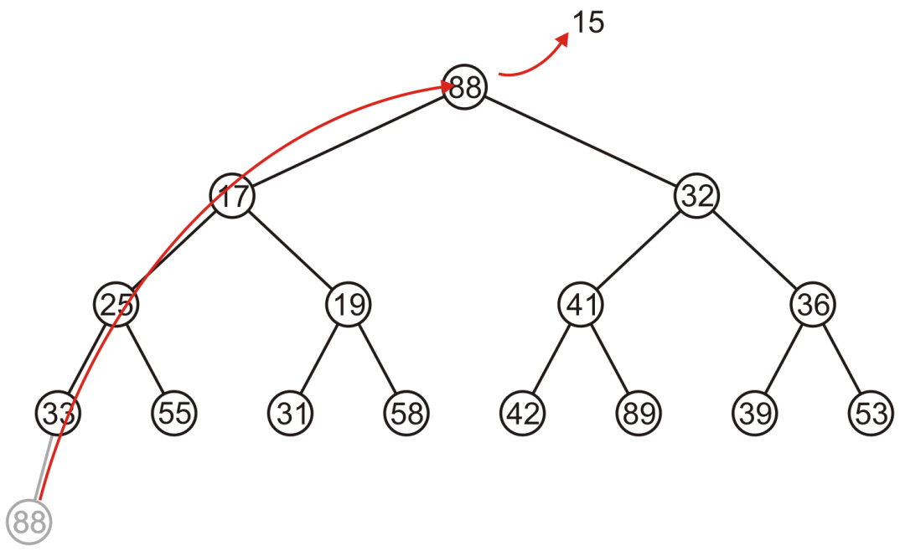
Complete Trees: Pop
Again, popping 15, copy up the last entry: 88

Slide 40
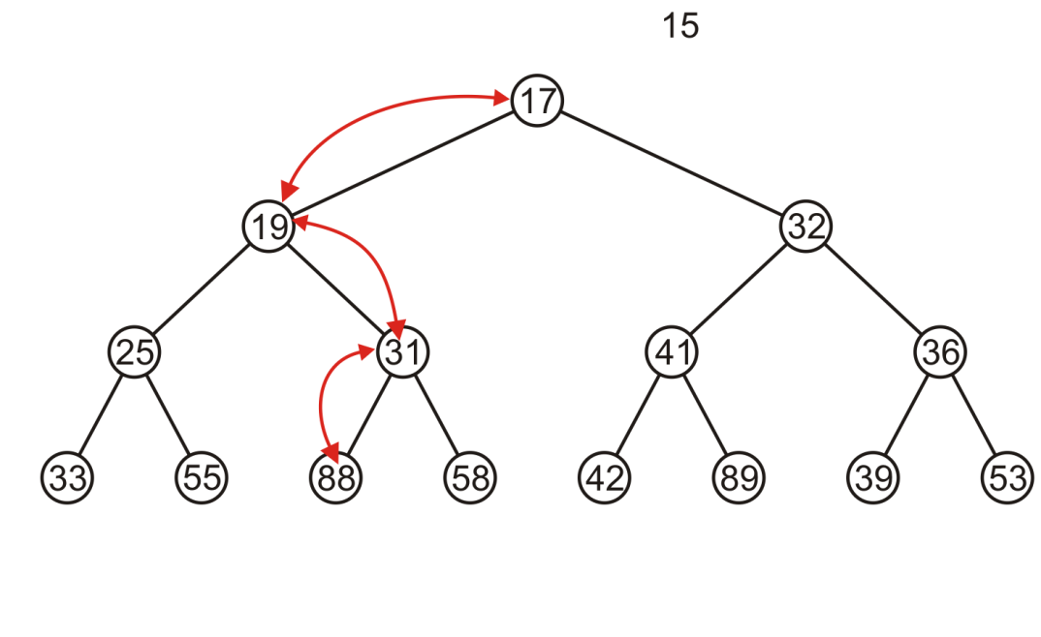
Complete Trees: Pop
This time, it gets percolated down to the point where it has no children

Slide 41
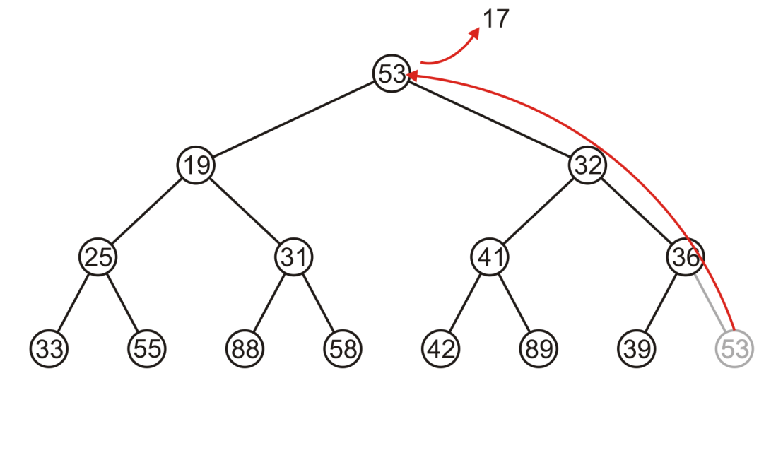
Complete Trees: Pop
In popping 17, 53 is moved to the top

Slide 42
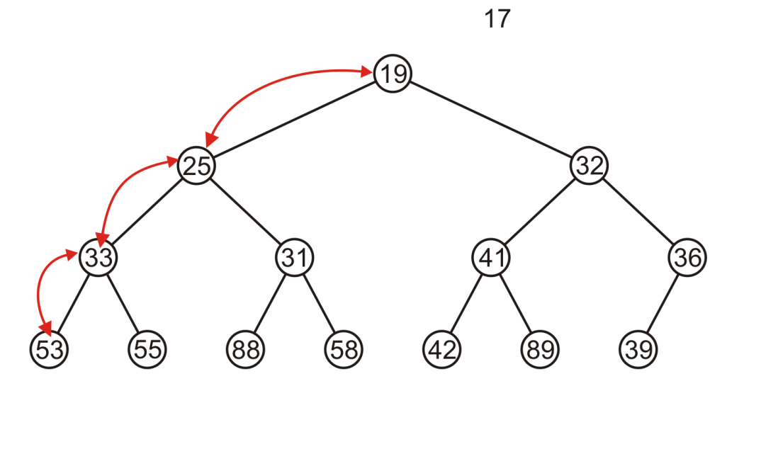
Complete Trees: Pop
And percolated down, again to the deepest level

Slide 43
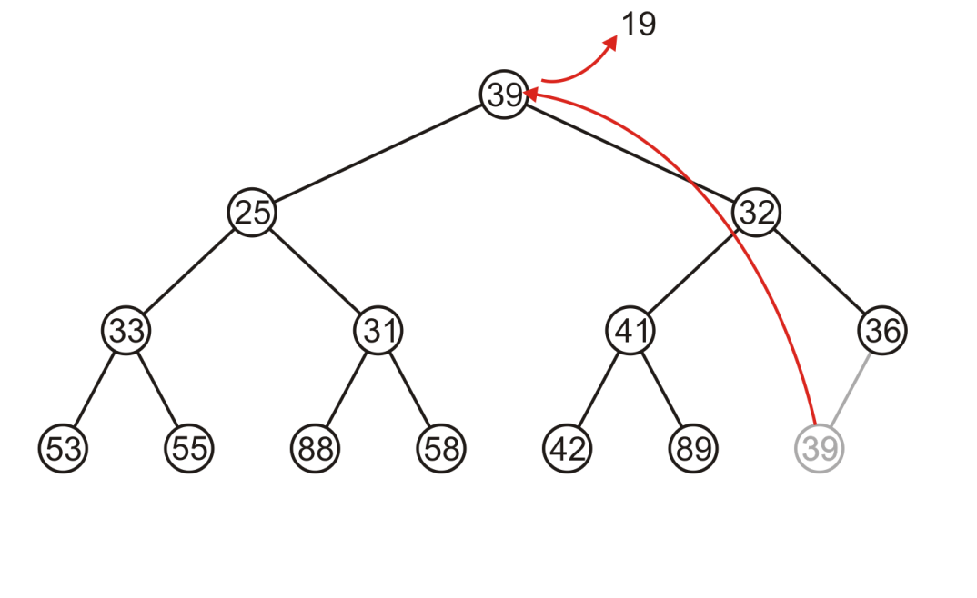
Complete Trees: Pop
Popping 19 copies up 39

Slide 44
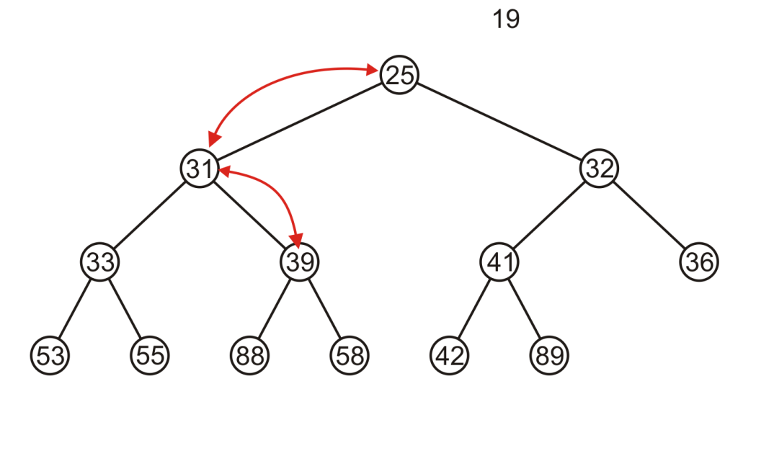
Complete Trees: Pop
Which is then percolated down to the second deepest level

Slide 45
Complete Tree
Therefore, we can maintain the complete-tree shape of a heap
We may store a complete tree using an array:
A complete tree is filled in breadth-first traversal order
The array is filled using breadth-first traversal

Slide 46

Array Implementation
For the heap
a breadth-first traversal yields:

Slide 47
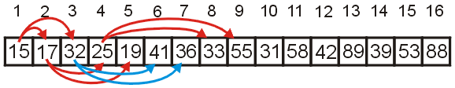
Array Implementation
Recall that If we associate an index–starting at 1–with each entry in the breadth-first traversal, we get:
Given the entry at index k, it follows that:
The parent of node is a k/2 parent = k >> 1;
the children are at 2k and 2k + 1 left_child = k << 1; right_child = left_child | 1;
Cost (trivial): start array at position 1 instead of position 0

Slide 48
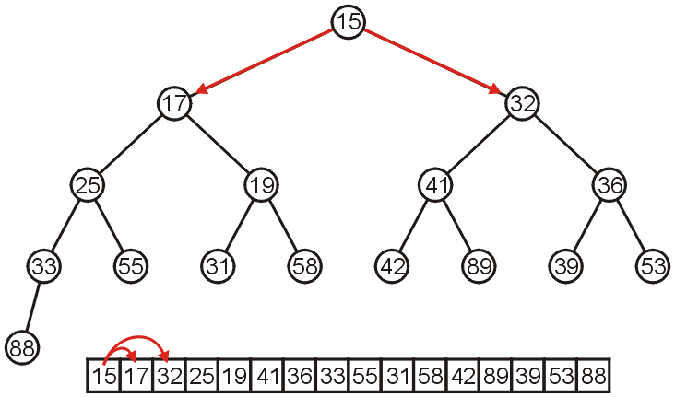
Array Implementation
The children of 15 are 17 and 32:

Slide 49
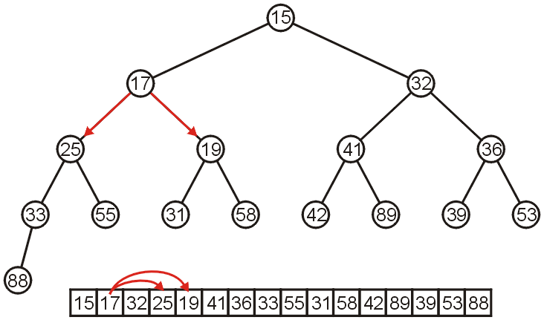
Array Implementation
The children of 17 are 25 and 19:

Slide 50
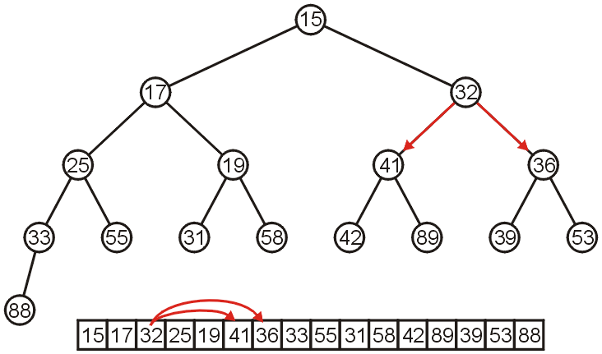
Array Implementation
The children of 32 are 41 and 36:

Slide 51
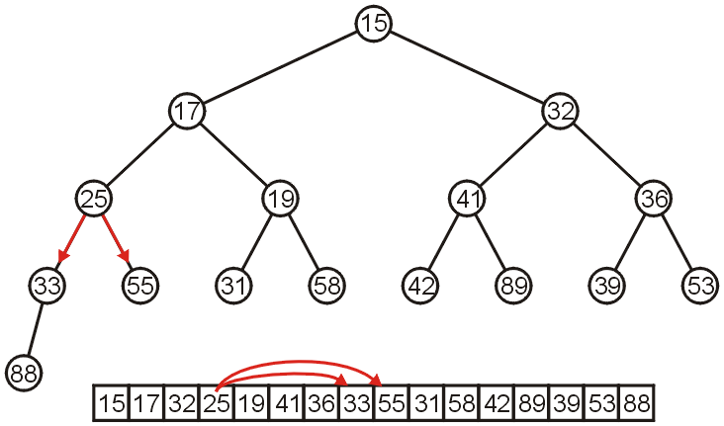
Array Implementation
The children of 25 are 33 and 55:

Slide 52
Array Implementation
If the heap-as-array has count entries, then the next empty node in the corresponding complete tree is at location posn = count + 1
We compare the item at location posn with the item at posn/2
If they are out of order
Swap them, set posn /= 2 and repeat

Slide 53
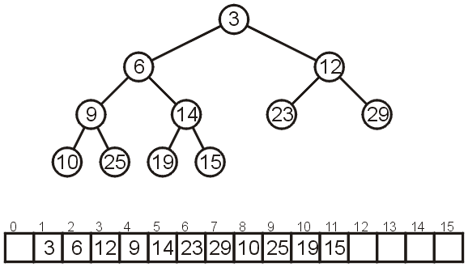
Array Implementation
Consider the following heap, both as a tree and in its array representation

Slide 54
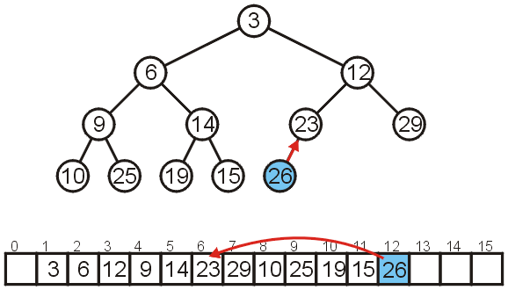
Array Implementation: Push
Inserting 26 requires no changes

Slide 55
Array Implementation: Push
Inserting 8 requires a few percolations:
Swap 8 and 23

Slide 56
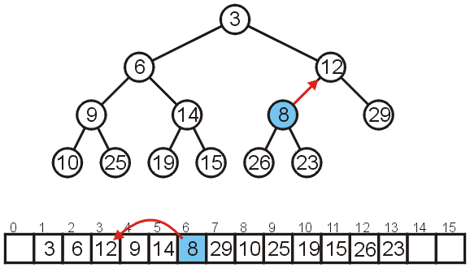
Array Implementation: Push
Swap 8 and 12

Slide 57
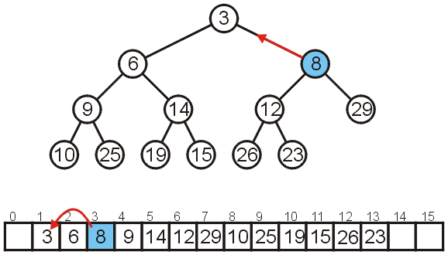
Array Implementation: Push
At this point, it is greater than its parent, so we are finished

Slide 58
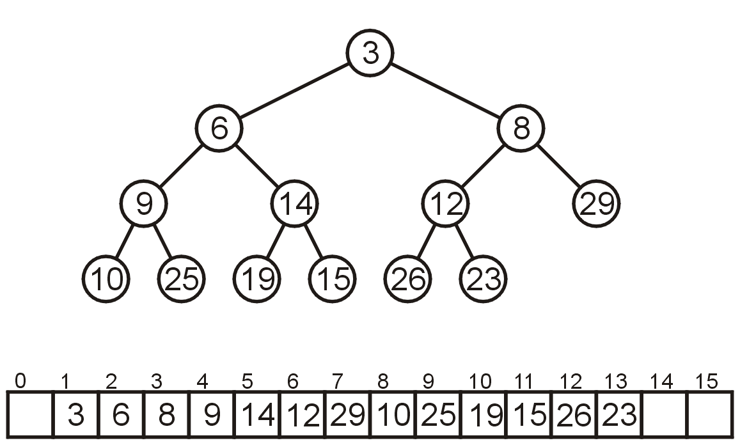
Array Implementation: Pop
As before, popping the top has us copy the last entry to the top

Slide 59
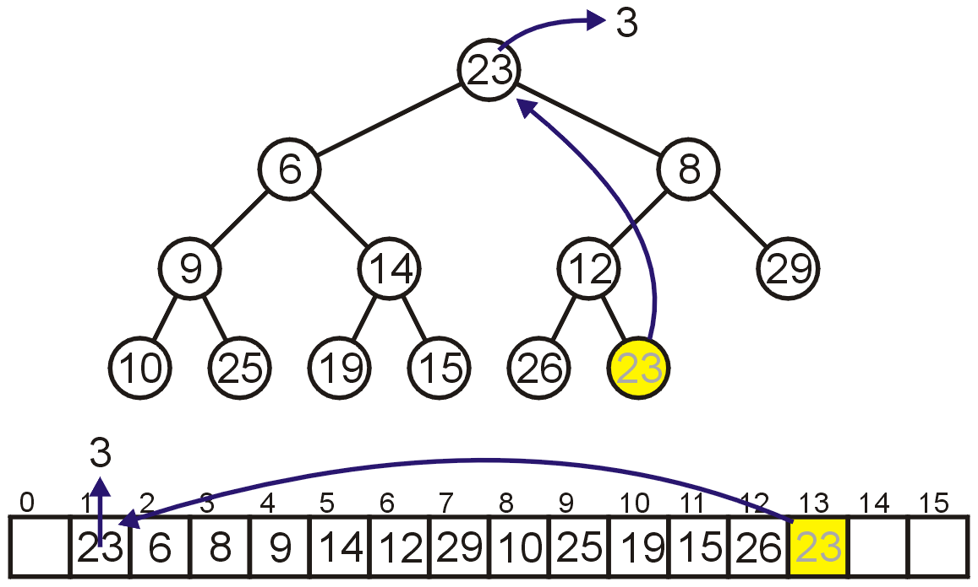
Array Implementation: Pop
Instead, consider this strategy:
Copy the last object, 23, to the root

Slide 60
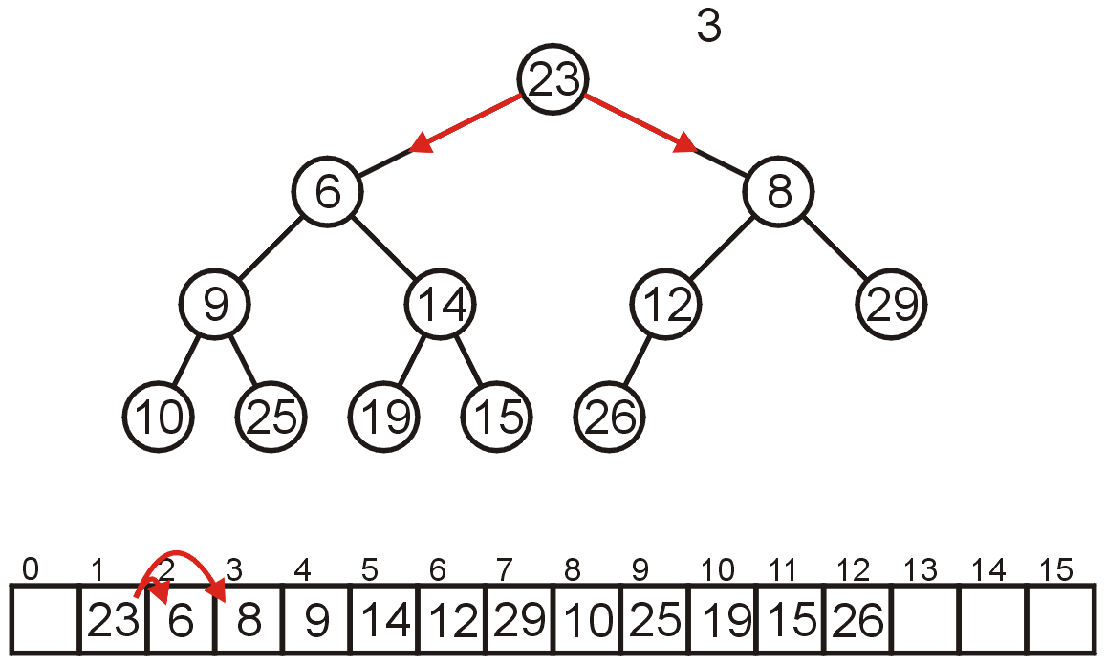
Array Implementation: Pop
Now percolate down
Compare Node 1 with its children: Nodes 2 and 3
Swap 23 and 6

Slide 61
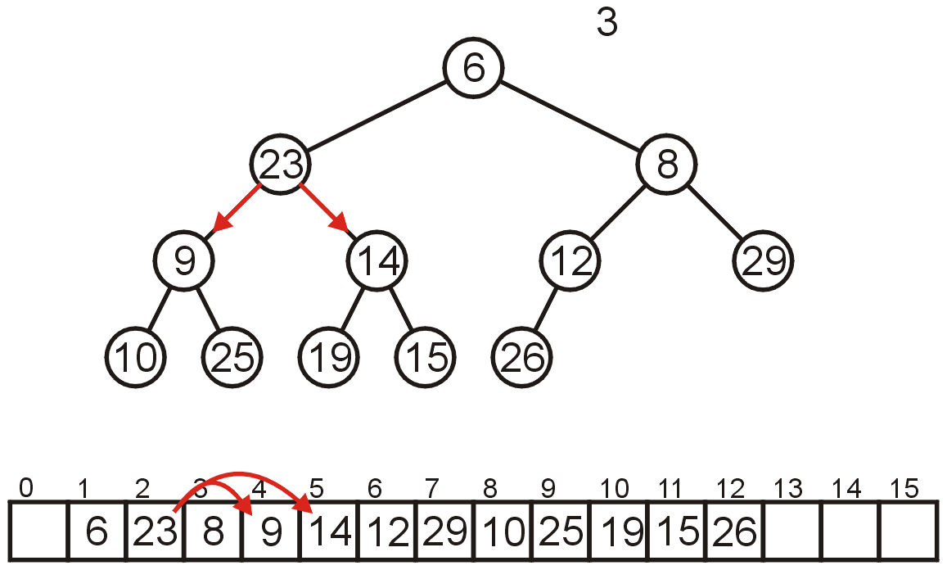
Array Implementation: Pop
Compare Node 2 with its children: Nodes 4 and 5
Swap 23 and 9

Slide 62
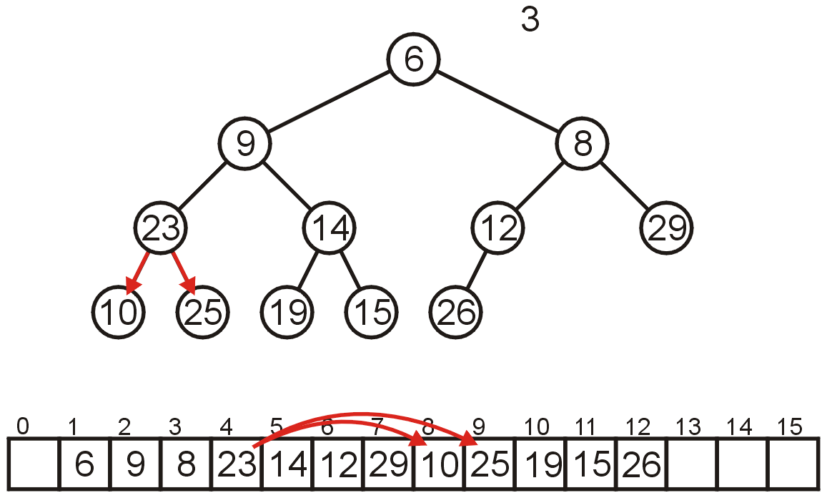
Array Implementation: Pop
Compare Node 4 with its children: Nodes 8 and 9
Swap 23 and 10

Slide 63
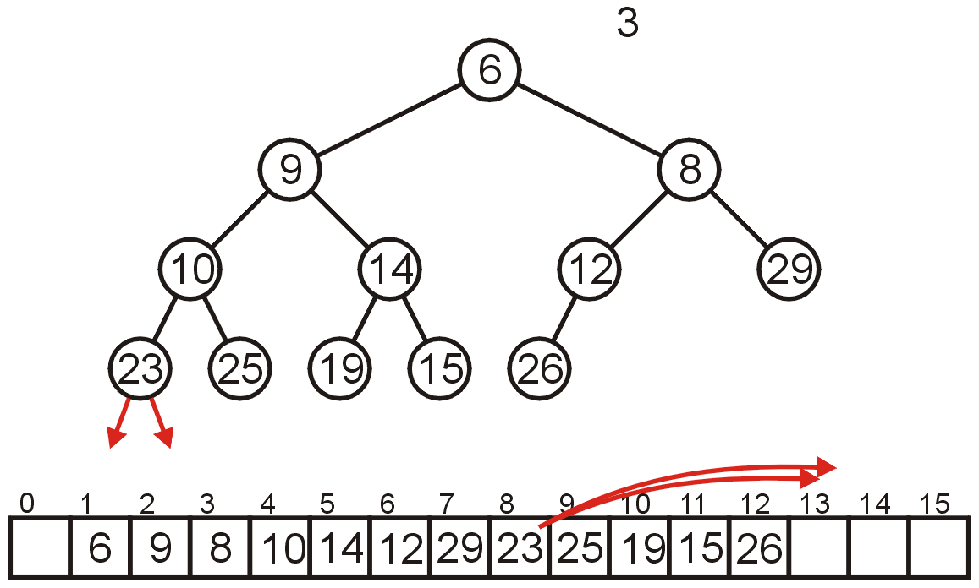
Array Implementation: Pop
The children of Node 8 are beyond the end of the array:
Stop

Slide 64
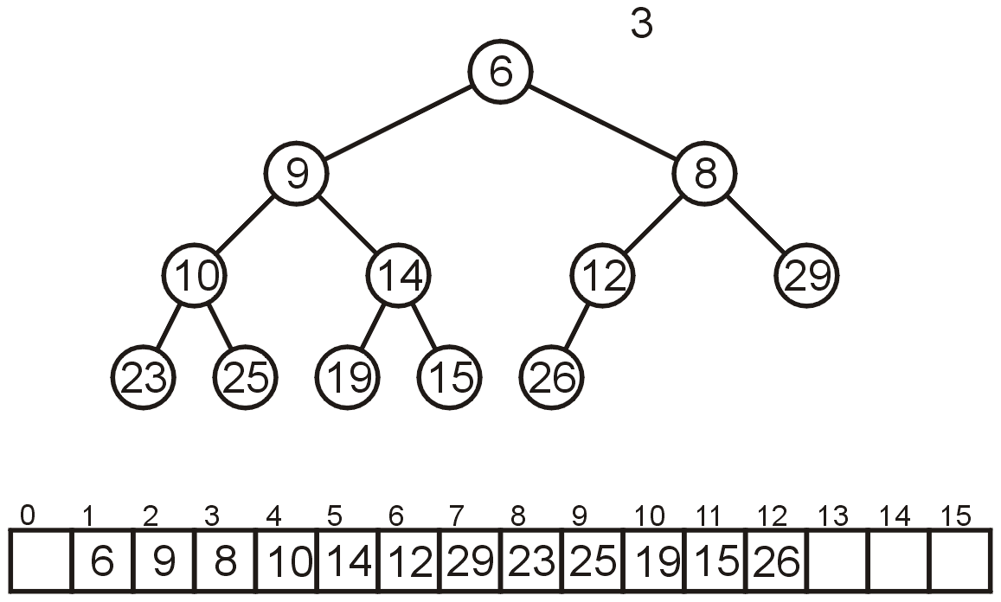
Array Implementation: Pop
The result is a binary min-heap

Slide 65
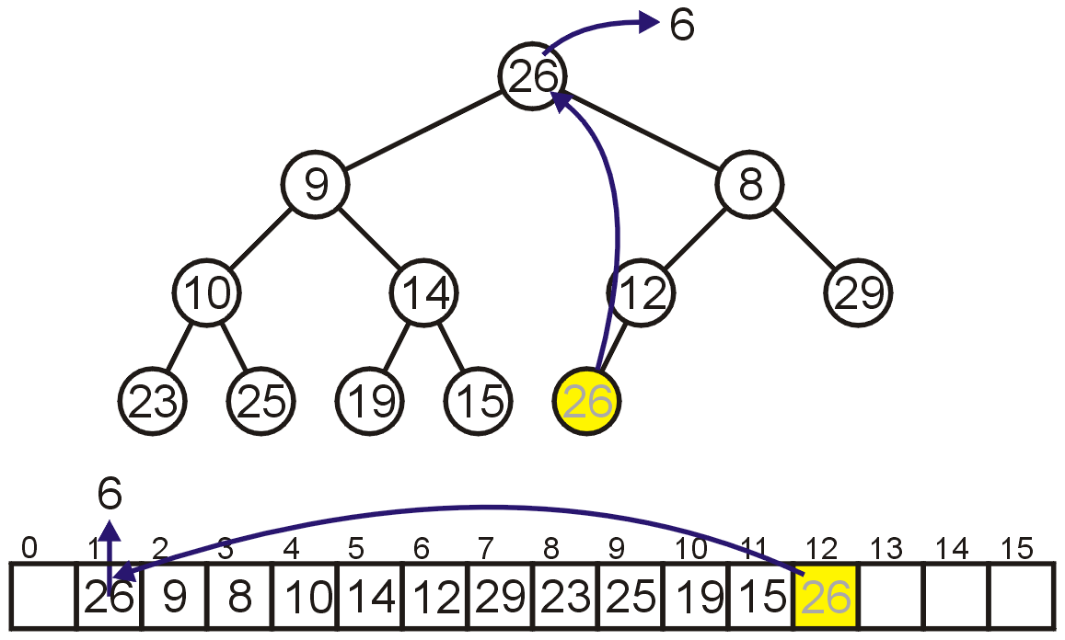
Array Implementation: Pop
Dequeuing the minimum again:
Copy 26 to the root

Slide 66

Array Implementation: Pop
Compare Node 1 with its children: Nodes 2 and 3
Swap 26 and 8

Slide 67

Array Implementation: Pop
Compare Node 3 with its children: Nodes 6 and 7
Swap 26 and 12

Slide 68

Array Implementation: Pop
The children of Node 6, Nodes 12 and 13 are unoccupied
Currently, count == 11

Slide 69

Array Implementation: Pop
The result is a min-heap

Slide 70

Array Implementation: Pop
Dequeuing the minimum a third time:
Copy 15 to the root

Slide 71

Array Implementation: Pop
Compare Node 1 with its children: Nodes 2 and 3
Swap 15 and 9

Slide 72

Array Implementation: Pop
Compare Node 2 with its children: Nodes 4 and 5
Swap 15 and 10

Slide 73

Array Implementation: Pop
Compare Node 4 with its children: Nodes 8 and 9
15 < 23 and 15 < 25 so stop

Slide 74

Array Implementation: Pop
The result is a properly formed binary min-heap

Slide 75

Array Implementation: Pop
After all our modifications, the final heap is

Slide 76
Run-time Analysis
Accessing the top object is Θ(1)
Popping the top object is O(ln(n))
We copy something that is already in the lowest depth—it will likely be moved back to the lowest depth

Slide 77
Run-time Analysis
If we are inserting an object less than the root (at the front), then the run time will be Θ(ln(n))
If we insert at the back (greater than any object) then the run time will be Θ(1)

Slide 78

Run-time Analysis
Thus, our grid of run times is given by:

Slide 79
Run-time Analysis
Some observations:
Continuously inserting at the front of the heap (i.e., the new object being pushed is less than everything in the heap) causes the run-time to drop to O(ln(n))
If the objects are coming in order of priority, use a regular queue with swapping
Merging two binary heaps of size n is a Θ(n) operation

Slide 80
Run-time Analysis
Other heaps have better run-time characteristics
Leftist, skew, binomial and Fibonacci heaps all use a node-based implementation requiring Θ(n) additional memory
For Fibonacci heaps, the run-time of all operations (including merging two Fibonacci heaps) except pop are Θ(1)
We will study Interval Heaps, Leftist Tree

Slide 81

Binary Max Heaps
A binary max-heap is identical to a binary min-heap except that the parent is always larger than either of the children
For example, the same data as before stored as a max-heap yields

Slide 82
Priority Queues
Now, does using a heap ensure that that object in the heap which:
has the highest priority, and
of that highest priority, has been in the heap the longest
Consider inserting seven objects, all of the same priority (colour indicates order):
2, 2, 2, 2, 2, 2, 2

Slide 83

Priority Queues
Whatever algorithm we use for promoting must ensure that the first object remains in the root position
Thus, we must use an insertion technique where we only percolate up if the priority is lower
The result:
Challenge:
Come up with an algorithm which removes all seven objects in the original order

Slide 84

Lexicographical Ordering
A better solution is to modify the priority:
Track the number of insertions with a counter k (initially 0)
For each insertion with priority n, create a hybrid priority (n, k) where:
(n₁, k₁) < (n₂, k₂) if n₁ < n₂ or (n₁ = n₂ and k₁ < k₂)

Slide 85
Priority Queues
Removing the objects would be in the following order:

Slide 86

Priority Queues
Popped: 2
First, (2,1) < (2, 2) and (2, 3) < (2, 4)

Slide 87

Priority Queues
Removing the objects would be in the following order:

Slide 88

Priority Queues
Removing the objects would be in the following order:

Slide 89

Priority Queues
Removing the objects would be in the following order:

Slide 90

Priority Queues
Removing the objects would be in the following order:

Slide 91
Summary
In this talk, we have:
Discussed binary heaps
Looked at an implementation using arrays
Analyzed the run time:
Head Θ(1)
Push Θ(1) average
Pop O(ln(n))
Discussed implementing priority queues using binary heaps
The use of a lexicographical ordering

Slide 92
d-ary heaps

Slide 93
Outline
In this topic, we will:
Definition of a d-ary min heap
Implementation as a complete tree
Examples of binary, ternary, quaternary, and quinary min heaps
Properties
Relative speeds
Optimal choice is a quaternary heap

Slide 94
Definition
The relationship between a binary min heap and a d-ary min heap is the same as a binary tree and an N-ary tree
Every node has up to d children
The relationship is the same—all children are greater than their parent

Slide 95
d-ary heaps as complete N-ary trees
The implementation of a d-ary heap is similar to that of a binary heap: use a complete N-ary tree which can be stored as an array
Observation:
With binary heaps, we started at index 1, and for the entry at index k:
The parent is at k/2
The children are at 2*k and 2*k + 1
Recall the form:
parent = k >> 1;
left_child = k << 1;
right_child = left_child | 1;

Slide 96
d-ary heaps as complete N-ary trees
Initial index | Calculations | Operations
1 | parent = (k - 2) >> 2; third_child = k << 2; first_child = third_child - 2; second_child = third_child - 1; fourth_child = third_child | 1; | 3 arithmetic 3 logic
0 | parent = (k - 1) >> 2; first_child = k << 2; second_child = first_child | 2; third_child = first_child | 3; fourth_child = first_child + 4; first_child |= 1; | 2 arithmetic 5 logic
-1 | parent = (k << 4) - 1; first_child = (k + 1) >> 2; second_child = first_child | 1; third_child = first_child | 2; fourth_child = first_child | 3; | 2 arithmetic 5 logic

Slide 97
d-ary heaps as complete N-ary trees
Finally, if we start at -1, our calculations are:
parent = (k < 4 ? -1 : k << 4;
first_child = (k + 1) >> 2;
second_child = first_child | 1;
third_child = first_child | 1;
fourth_child = first_child | 1;
Now, if we start at index 0, our calculations are:
parent = (k - 1) >> 2;
first_child = k << 2;
second_child = first_child | 2;
third_child = first_child | 3;
fourth_child = first_child + 4;
first_child |= 1;

Slide 98
d-ary heaps as complete N-ary trees
The implementation of a d-ary heap is similar to that of a binary heap: we use a complete N-ary tree which can be stored as an array
To find the root, children, and parent:
The root is at 0 (not 1 like a binary heap)
The children of k are at:
dk + 1, dk + 2, ..., dk + d
The parent of k is at for k > 0

Slide 99

Examples
Example of a binary min-heap:
0 | 1 | 2 | 3 | 4 | 5 | 6 | 7 | 8 | 9 | 10 | 11 | 12 | 13 | 14 | 15 | 16 | 17
2 | 5 | 4 | 16 | 7 | 9 | 11 | 15 | 31 | 27 | 12 | 26 | 35 | 23 | 14 | 18 | 17 | 42

Slide 100

Examples
The same 18 elements in a ternary min-heap:
0 | 1 | 2 | 3 | 4 | 5 | 6 | 7 | 8 | 9 | 10 | 11 | 12 | 13 | 14 | 15 | 16 | 17
2 | 11 | 4 | 5 | 12 | 17 | 14 | 18 | 31 | 27 | 7 | 9 | 35 | 23 | 16 | 15 | 26 | 42

Slide 101

Examples
In a quaternary min-heap:
0 | 1 | 2 | 3 | 4 | 5 | 6 | 7 | 8 | 9 | 10 | 11 | 12 | 13 | 14 | 15 | 16 | 17
2 | 16 | 4 | 7 | 12 | 26 | 14 | 18 | 31 | 27 | 5 | 9 | 35 | 23 | 11 | 15 | 17 | 42

Slide 102

Examples
And a quinary heap:
0 | 1 | 2 | 3 | 4 | 5 | 6 | 7 | 8 | 9 | 10 | 11 | 12 | 13 | 14 | 15 | 16 | 17
2 | 5 | 4 | 7 | 12 | 26 | 16 | 18 | 31 | 27 | 14 | 9 | 35 | 23 | 11 | 15 | 17 | 42

Slide 103
Properties
The properties of a complete d-ary heap are:
The average depth of a node is given by the formula
The proportion of leaf nodes to the full number of nodes is approximately

Slide 104
Properties
For example, in a complete quaternary heap:
The average height of a node is h – ⅓, and
The leaf nodes comprise ¾ of all nodes
Therefore:
A push will require approximately 1⅓ comparisons and ⅓ copies
A pop will require almost 4h comparisons (= (3 + 1)h) and h + 1 copies

Slide 105
Relative Speed
In general, d-ary heaps have different performance versus binary heaps:
A d-ary heap makes log_{d}(n) comparisons for each push (worst case)
Percolating up compares only the parent
A d-ary heap must, however, make d log_{d}(n) comparisons for each pop
Percolating down compares a node with all d children
Assuming an equal number of pushes and pops:
log_{d} (n) + d log_{d} (n) = (d + 1) log_{d}(n)

Slide 106
d-ary Heap
Complete n node tree whose degree is d.
Min (max) tree.
Number nodes in breadth-first manner with root being numbered 1.
Parent(i) = ceil((i – 1)/d).
Children are d*(i – 1) + 2, …, min{d*i + 1, n}.
Height is log_{d}n.
Height of 4-ary heap is half that of 2-ary heap.

Slide 107
d = 4, 4-Heap
Worst-case insert moves up half as many levels as when d = 2.
Average remains at about 1.6 levels.
Remove-min operations now do 4 compares per level rather than 2 (determine smallest child and see if this child is smaller than element being relocated).
But, number of levels is half.
Other operations associated with remove min are halved (move small element up, loop iterations, etc.)

Slide 108
d-ary Heap Performance
Speedup of about 1.5 to 1.8 when sorting 1 million elements using heapsort and cache-aligned 4-heap vs. 2-heap that begins at array position 0.
Cache-aligned 4-heap generally performs as well as, or better, than other d-heaps.
Use degree 4 complete tree for interval heaps instead of degree 2.
Notes:
Interval heap recommendation assumes 8-bytes/node (I.e., 4-bytes/element) or larger cache line.

Slide 109
Lexicographical Priority
Priority may also depend on multiple variables:
Two values specify a priority: (a, b)
A pair (a, b) has higher priority than (c, d) if:
a < c, or
a = c and b < d
For example,
(5, 19), (13, 1), (13, 24), and (15, 0) all have higher priority than (15, 7)

Slide 110
Implementations
Our goal is to make the run time of each operation as close to Θ(1) as possible
We will look at two implementations using data structures we already know:
Multiple queues—one for each priority

